Slide 1
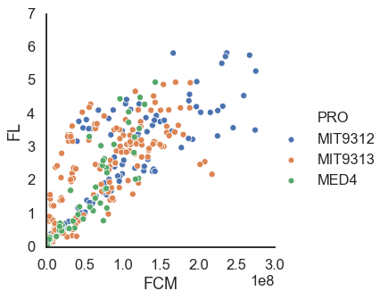
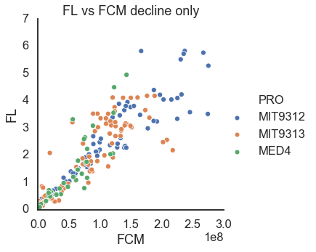
FCM vs FL in other experiments
R² = 0.85
R² = 0.92

Slide 2
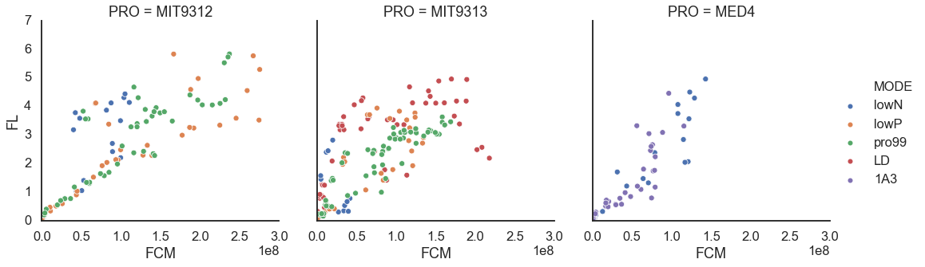
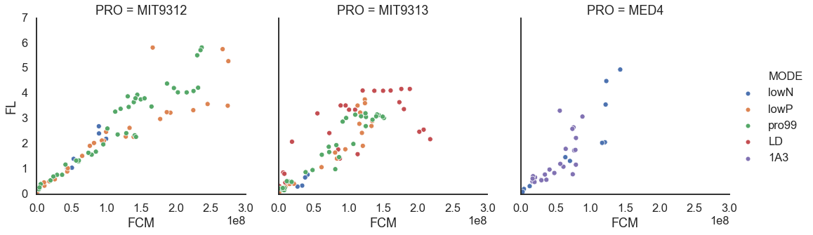
All measurements
R² = 0.88
R² = 0.82
R² = 0.92
Decline only
R² = 0.95
R² = 0.90
R² = 0.90

Slide 3
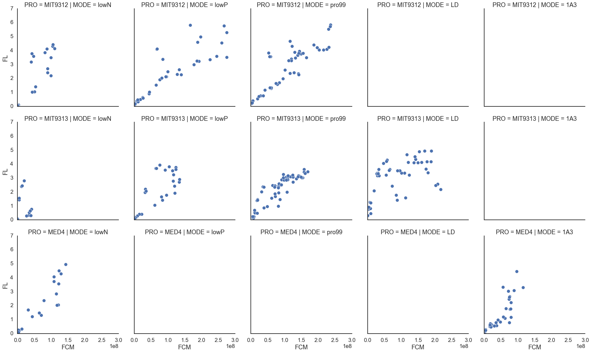
R² = 0.88
R² = 0.88
R² = 0.93
R² = 0.22
R² = 0.86
R² = 0.94
R² = 0.74
R² = 0.94
R² = 0.86

Slide 4
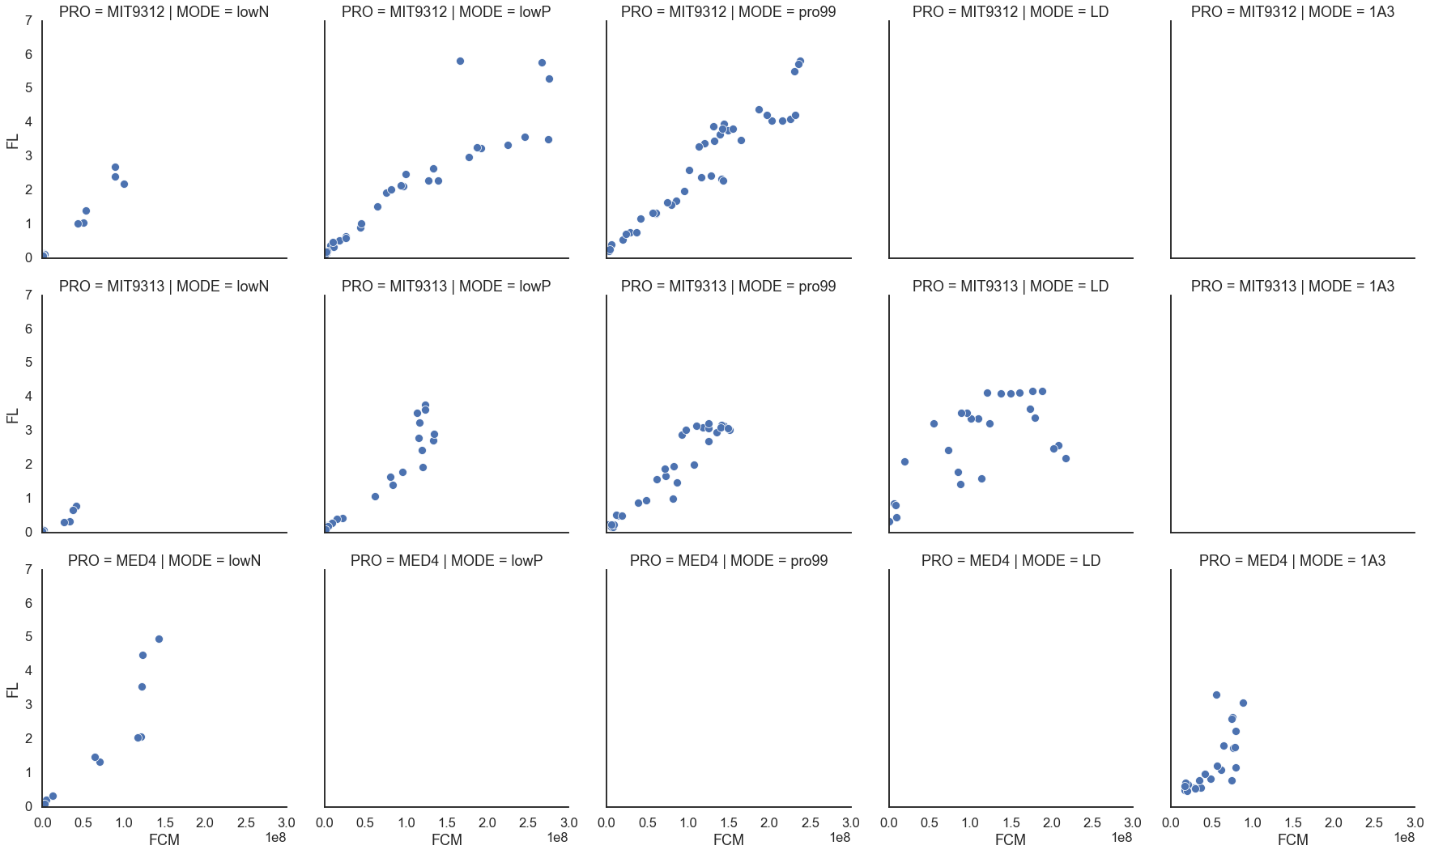
Decline only
R² = 0.98
R² = 0.93
R² = 0.97
R² = 0.92
R² = 0.95
R² = 0.97
R² = 0.84
R² = 0.92
R² = 0.85

